Slide 1
Feasibility Analysis
Shadheen - Online Employment Exchangement Portal

Slide 2
Group Members
Asifujjaman Opi - 011181295
Md. Shahriar Asif Rezan -011181040
Khorshed Alam - 011181173
Alok Das - 011181236
Apu Chandra Bhowmick - 011181291
Md. Sabbir Sarkar - 011181197

Slide 3
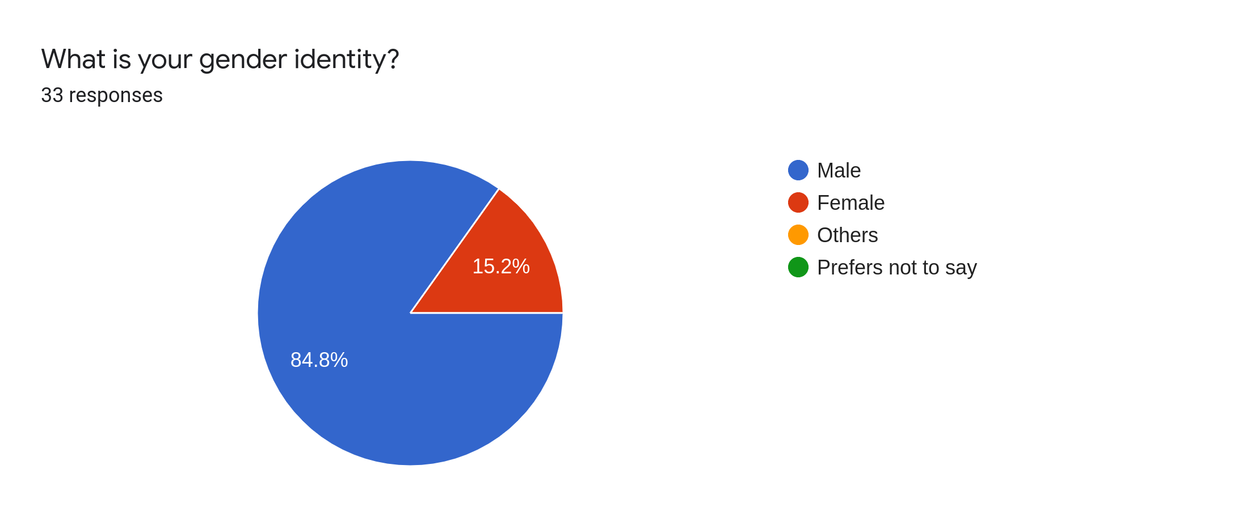

Slide 4
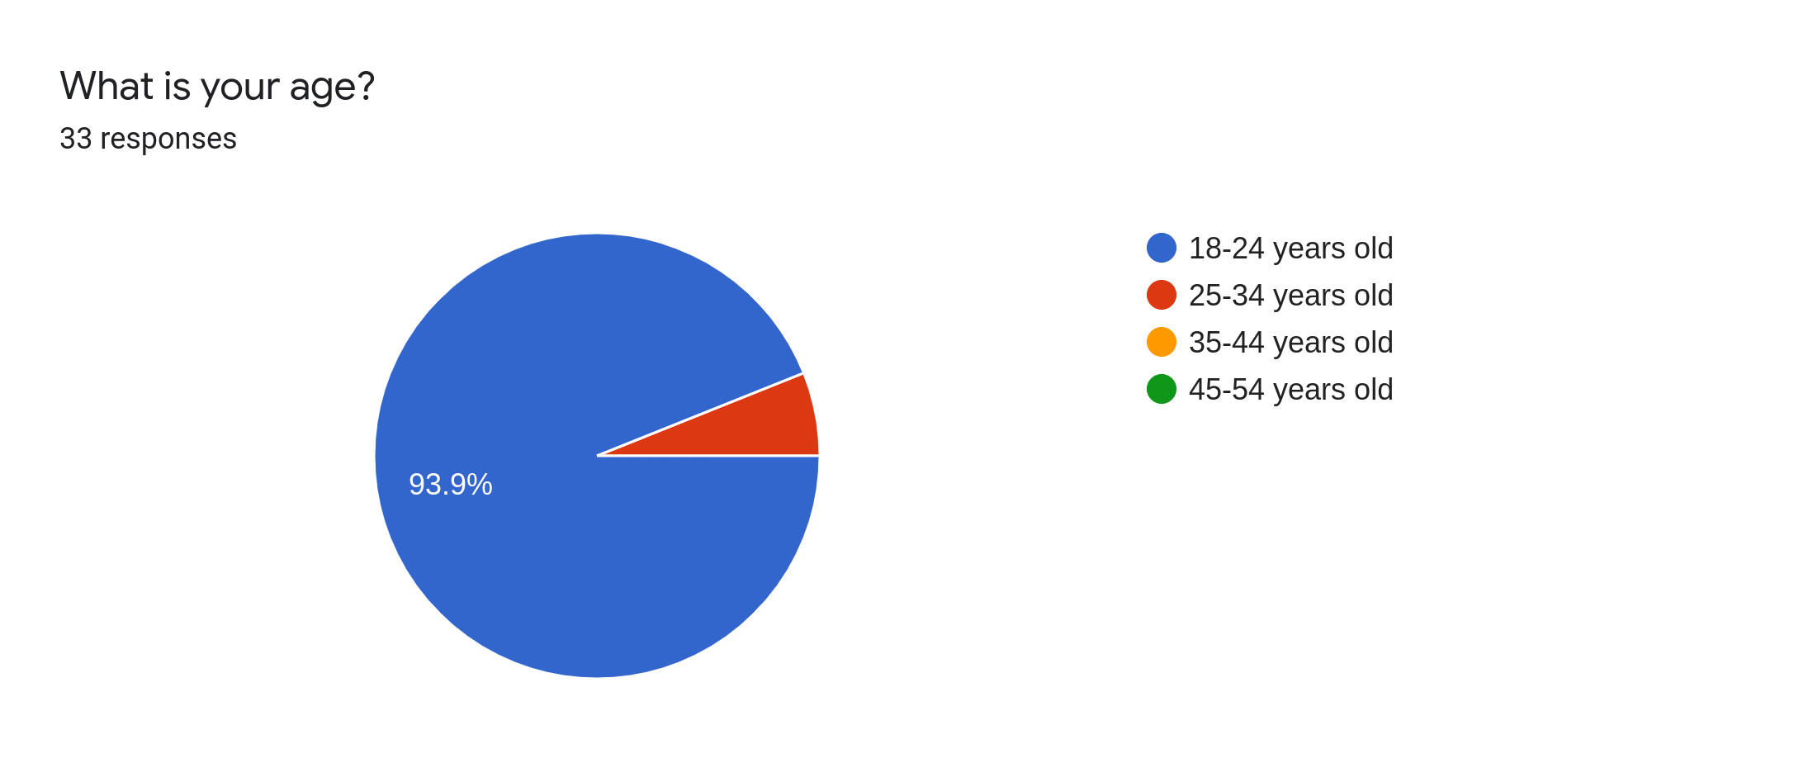

Slide 5
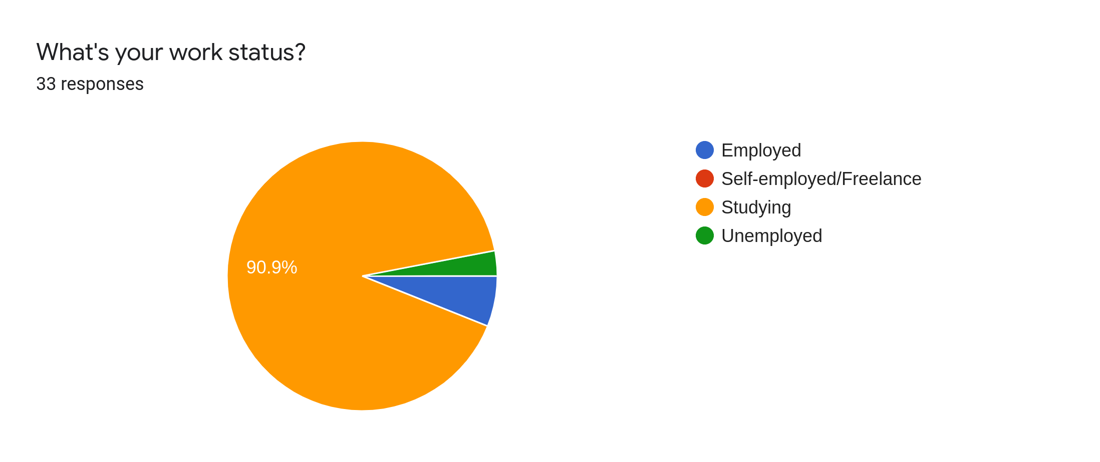

Slide 6
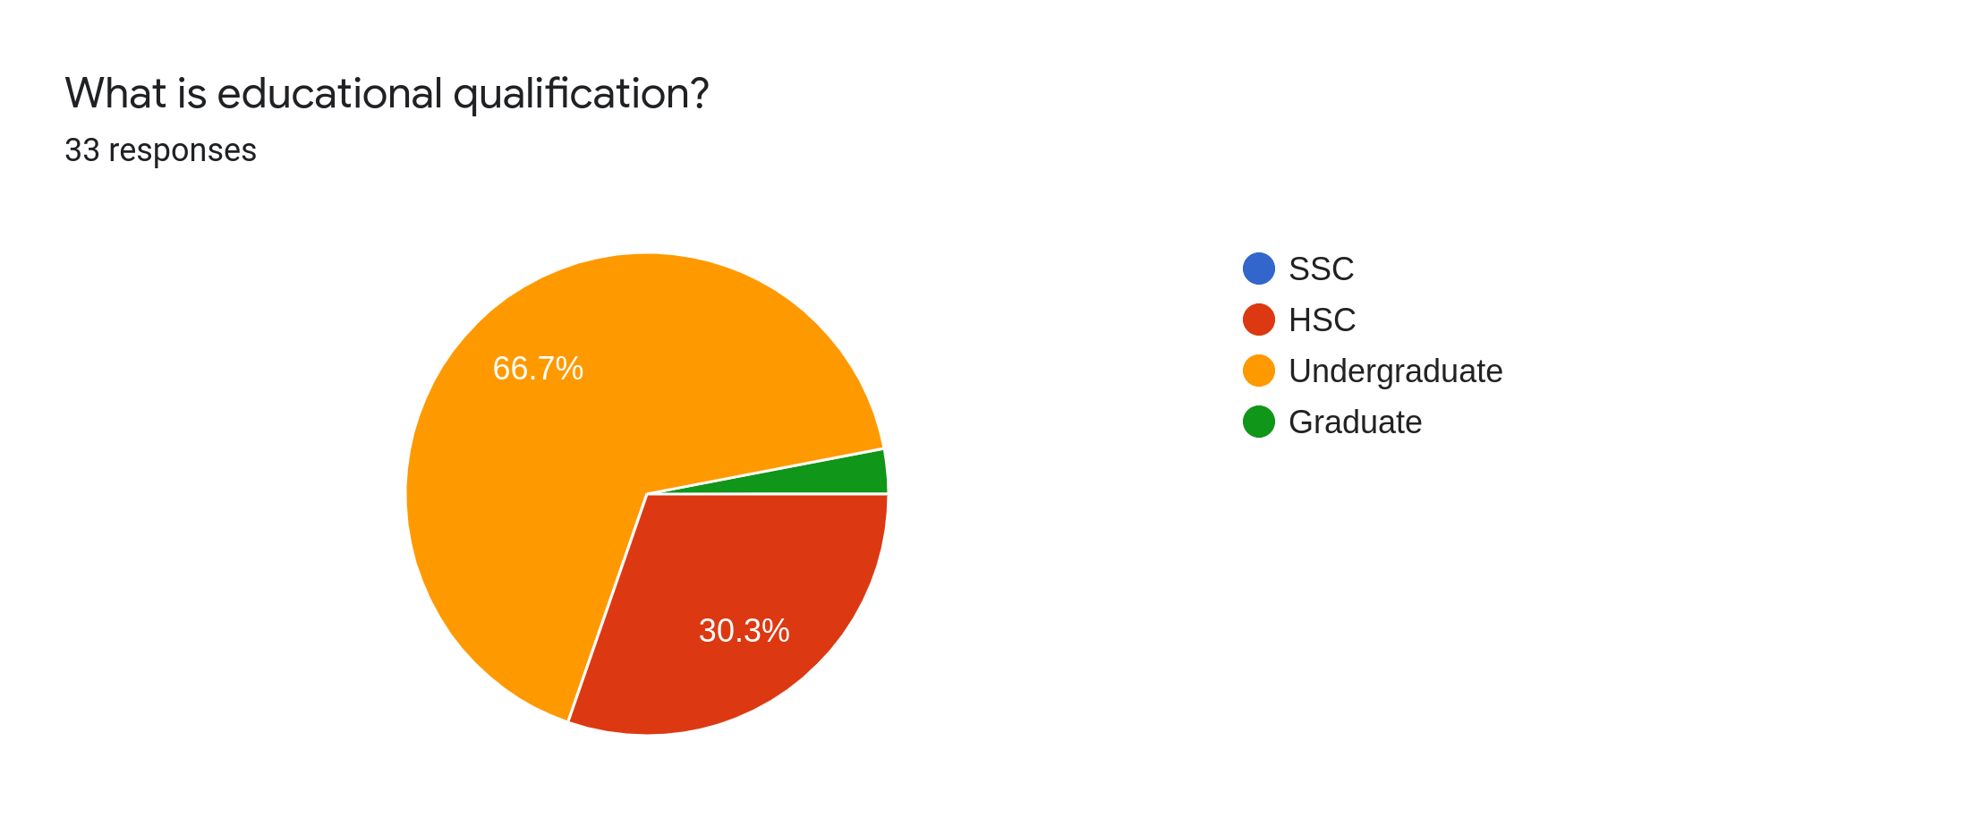

Slide 7
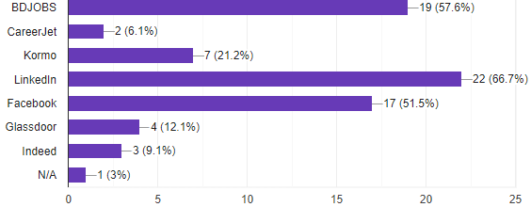
Which one of these job sites you have experienced before? | Decision
 | As most of the users like LinkedIn and BDJOBS so we are going to make our site in such a way that user will find it useful.

Slide 8
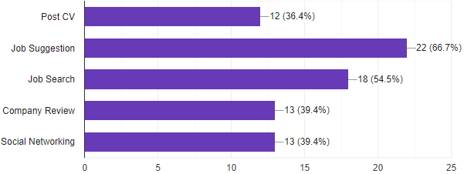
What kinds of feature do you like most in other sites as a job seeker? | Decision
 | We are going to keep Post CV and Job Search We are going to discard Job Suggestion and Social Networking We have added Company Review in feature list

Slide 9
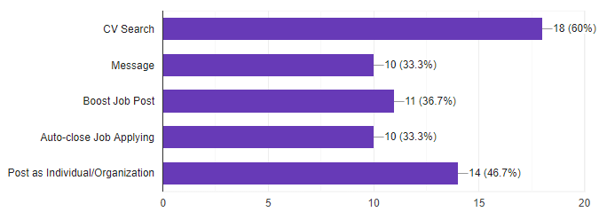
What features you experienced in other sites as a recruiter? | Decision
 | We are going to keep CV Search and Message feature We have added Boost Job Post and we are interested to take some money for this feature. Also, we will set expire limit for applying for a job post. Lastly, a user can open job posting on behalf of company or themselves.

Slide 10
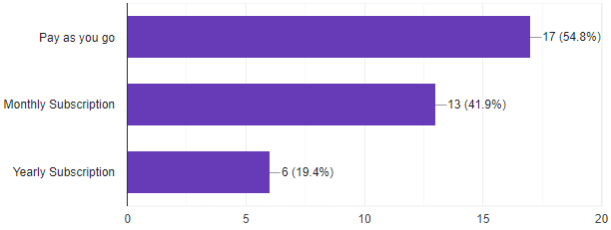
What kind of payment do you find useful as a job recruiter in other sites? | Decision
 | We are considering three of these subscription scheme.

Slide 11
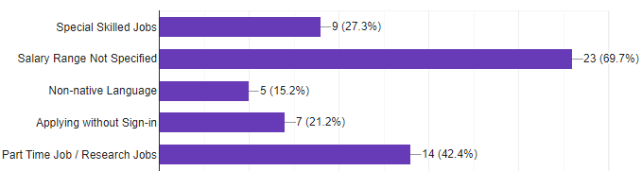
Did you find any of this lacking's in other sites? | Decision
 | A recruiter must mention salary range Job seeker can apply for special skilled jobs Also we will have part time and research jobs

Slide 12
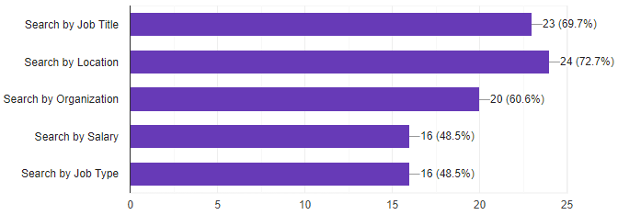
Which search filter will you like to see in our site? | Decision
 | We are going to keep search filter by Job Title and Location We are going to add Search by Organization, Job Type and Salary Range.

Slide 13
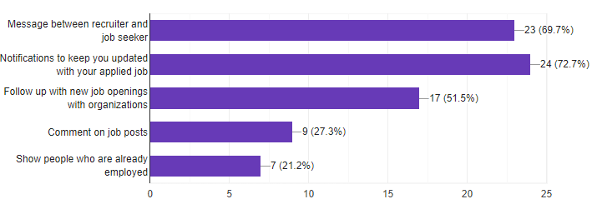
What kinds of connectivity features you will like to see to in our site? | Decision
 | We are going keep message and notifications. We are going to add following Organizations for new jobs. We are going discard commenting on job posts and showing people who are already employed in a company.

Slide 14
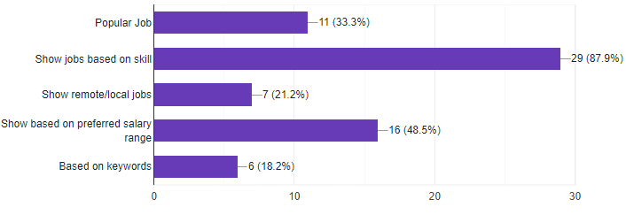
How do you want your job feed in our site? | Decision
 | Keywords i.e. Java, Android, Web Salary Range i.e. 25K - 30K Skill i.e. Programming, MS Office, Editing

Slide 15
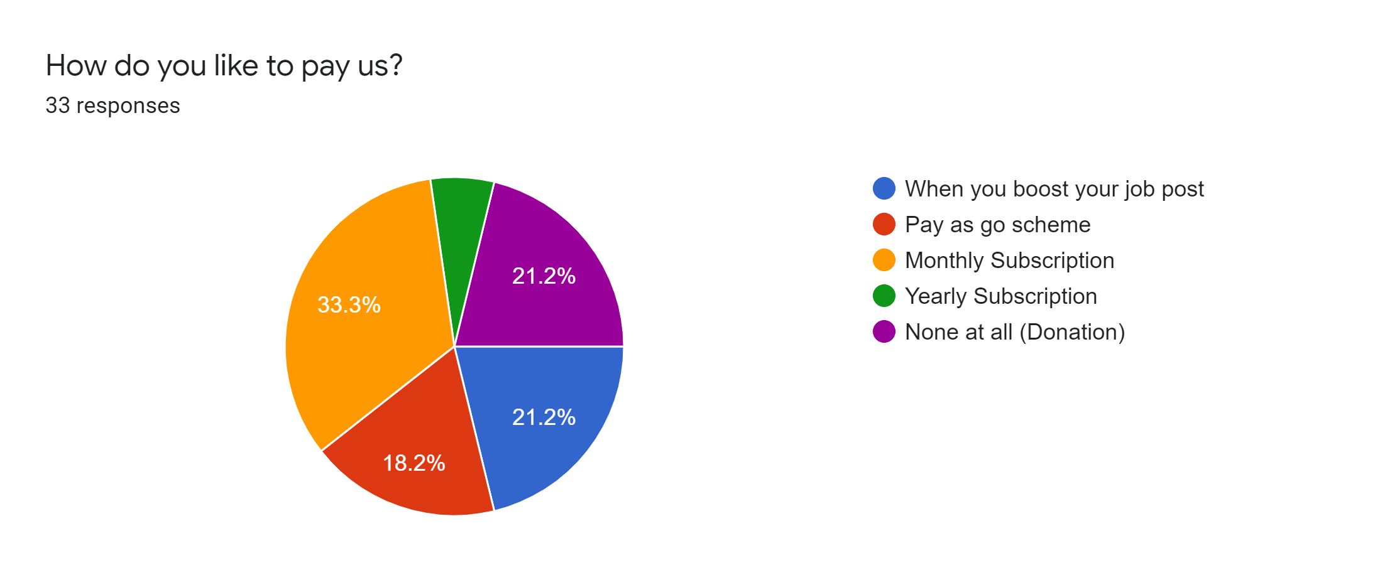

Slide 16
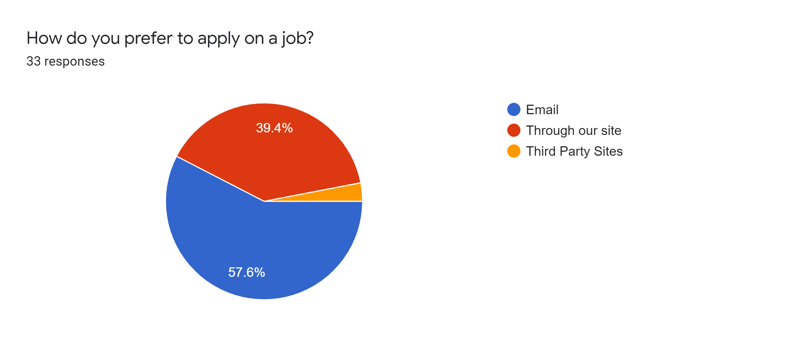

Slide 17
Features
Create / Upload CV
Search Filter
Browse Category
Easy Apply
Job Feed
Post Job
CV Search
Payment
Message
Notification
Company Review
Boost Job Post
Auto-close Job Posts
Job Type
Follow up Organizations

Slide 18
Shadheen - Online Employment Exchangement Portal
Strengths Synchronization between group members Almost everyone have understandable knowledge about writing codes Have previous experience to make similar projects | Opportunities Our software is open source We will deploy our project in strong infrastructure We will find investor to marketize our product and grow more
Weaknesses Lack of experience of making professional software We don’t have enough developer to grow further Lack of guideline and documentation of experience programmers | Threats We can not ensure security for now We don’t have enough financial backup to grow more We don’t have dedicated business expert to support this project
Strategy Better job feed, rich search filter, variation in job types will help job seeker to find more suitable job.

